Slide 1
Credit Card Approvals: Project Proposal

Slide 2
Background
While credit usage in America is widespread and most Americans have at least one credit card, the application process required to open a card can be tiresome. In order to get approved for a credit card, applicants are often evaluated on not only their credit score, but other factors such as income, expenditures, family, and history.
For the final project, we are interested in using multiple methods we have learned over the semester to classify credit card applicants as approved or denied for a card using a categorical "yes" or "no" outcome.

Slide 3
Dataset Overview & Objective
The credit card dataset was uploaded to Kaggle by user DanB and was originally published with the 5th edition of economist William Greene's book Econometric Analysis. The dataset can be found at the following link: https://www.kaggle.com/dansbecker/aer-credit-card-data
This dataset contains 1319 observations of 12 variables. Overall, there are 1023 credit card applicants in the dataset who were approved and 296 who were denied approval.
The outcome variable in which we are interested is card, which returns a "yes" if the applicant was approved and a "no" if denied. We will convert this to a binary variable to return 1 if approved and 0 if denied. Our main objective will be to use different data mining algorithms in order to classify records as approved or denied based on the values of their 11 predictors.
There are 2 categorical predictors (owner and selfemp), and 9 numeric predictors (reports, age, income, share, expenditure, dependent, months, majorcards, and active). Descriptions of each variable are on the next slide.

Slide 4
Variable Descriptions
card: categorical variable that takes on "yes" if the application was approved or "no" if the application was denied
reports: number of derogatory item reports
age: age in years of the applicant
income: annual income of the applicant, divided by 10,000
share: ratio of monthly credit card spending compared to annual income
expenditure: applicant's average monthly credit card spending
owner: categorical variable that takes on "yes" if the applicant owns their home and "no" if the applicant does not
selfemp: categorical variable that takes on "yes" if the applicant is self-employed and "no" if the applicant is not
dependents: the number of dependents claimed by the applicant
months: number of months applicant has been living at their current address
majorcards: number of major credit cards the applicant has
active: number of active credit accounts the applicant has

Slide 5
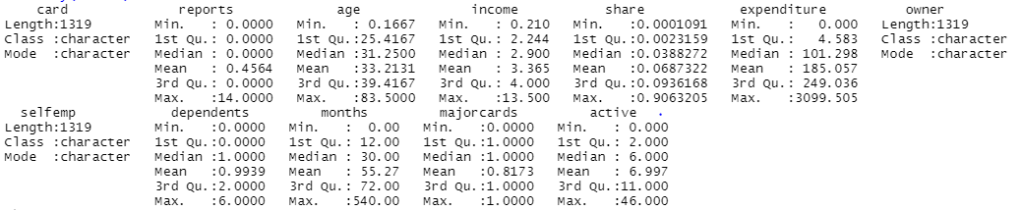
Summary Statistics
The summary statistic show that there are no NAs or missing data to be handled in the credit card dataset.
We see that there are 3 categorical variables, for which we will need to make dummy variables.
Our numeric predictors seem to take on different magnitudes, and we will need to standardize everything to a 0-1 scale before attempting to use some of our algorithms for classification.

Slide 6
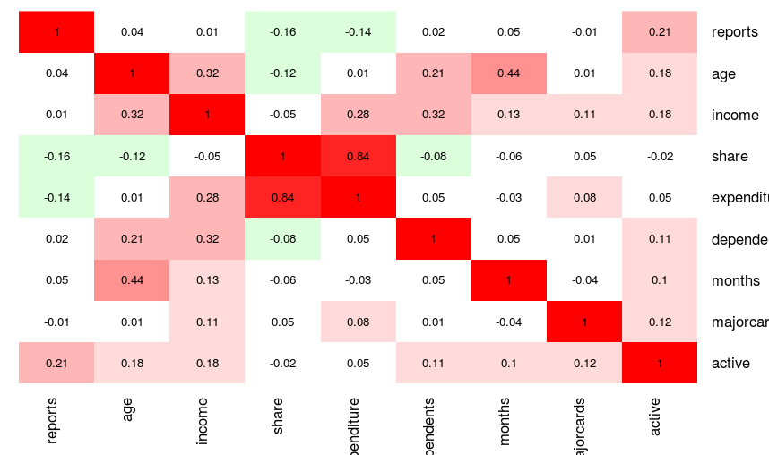
Heat Map
share and expenditure have a strong positive correlation (0.84), which makes sense because as someone spends more using their credit card, we would expect the ratio of credit card expenditure to annual income to increase as well.
There is moderate positive correlation between age and months - the older an applicant is may be somewhat related to how long they have lived at their current address, but the relationship is not very strong.
Many of the variables actually seem to have very little correlation with others.

Slide 7
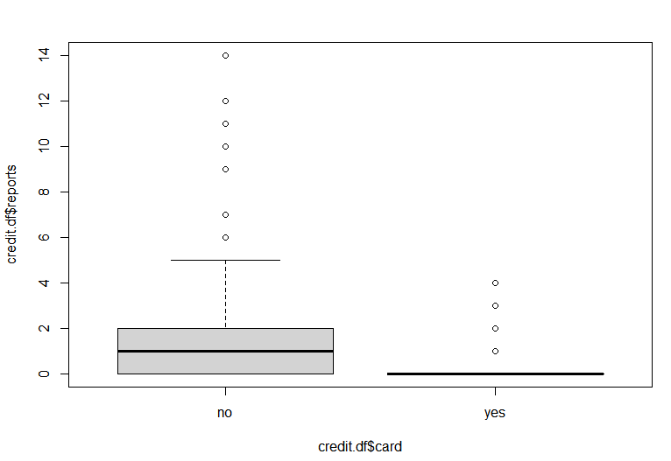
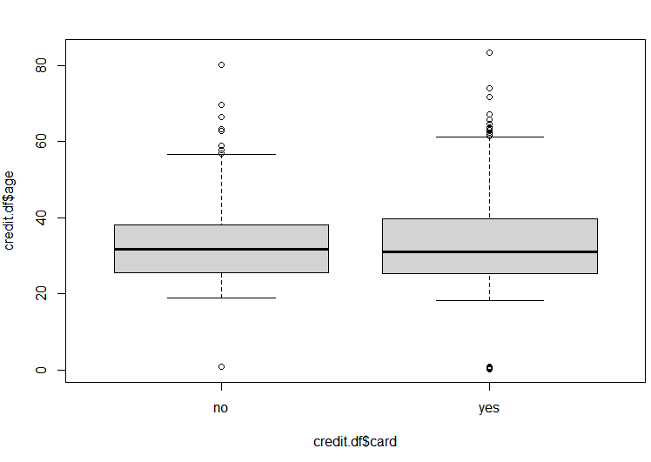
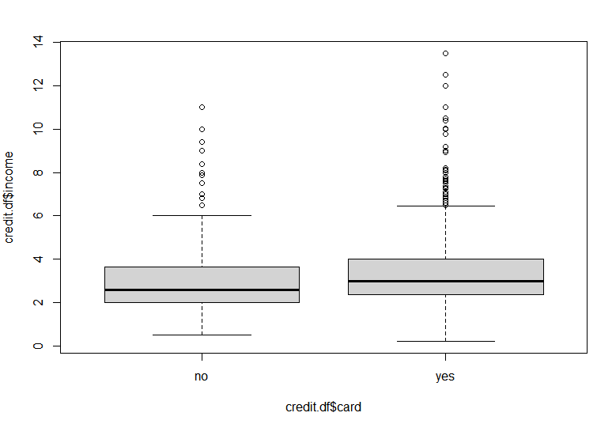
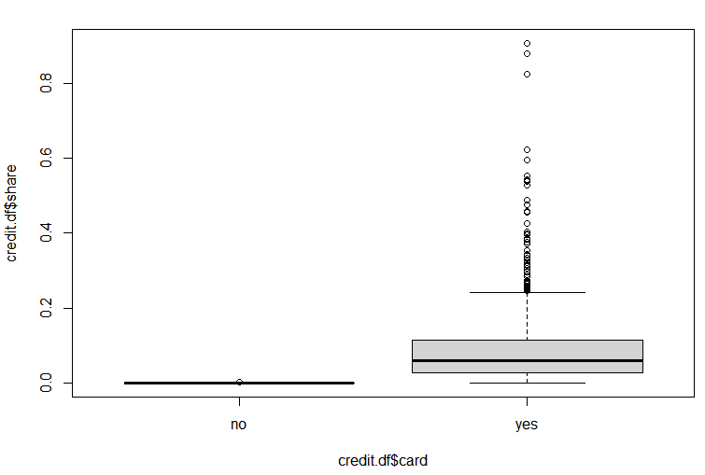
Side-By-Side Box Plots
Side-by-side box plots were created to show the distribution of numerical predictors reports, age, income, and share by whether the applicant was approved, shown below:
We see that the box plots for age and income do not show much difference in distribution between "no" and "yes" for the card outcome variable, so they may not be the most useful in predicting whether an applicant is approved. It appears that, of the four numerical predictors above, reports and share have the most distinct differences between "no" and "yes" distributions, and it seems that the medians are further away from each other. Therefore, based on the box plots we believe # derogatory reports and share ratio may be useful predictors in determining credit card application approval.

Slide 8
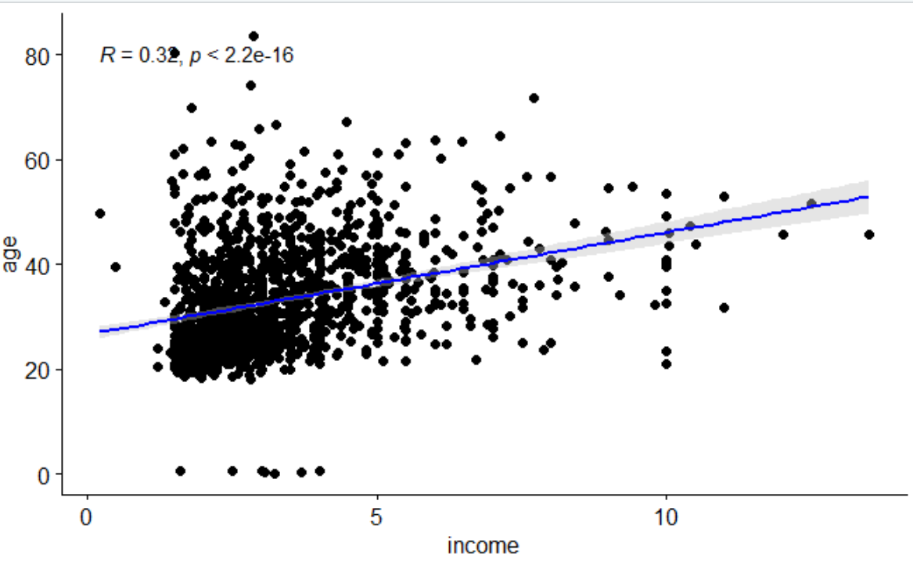
Scatter Plot
This scatter plot shows the correlation between age and income for the credit card applicants in our dataset.
There is a positive correlation showing that income of credit card applicants generally increases with age.

Slide 9
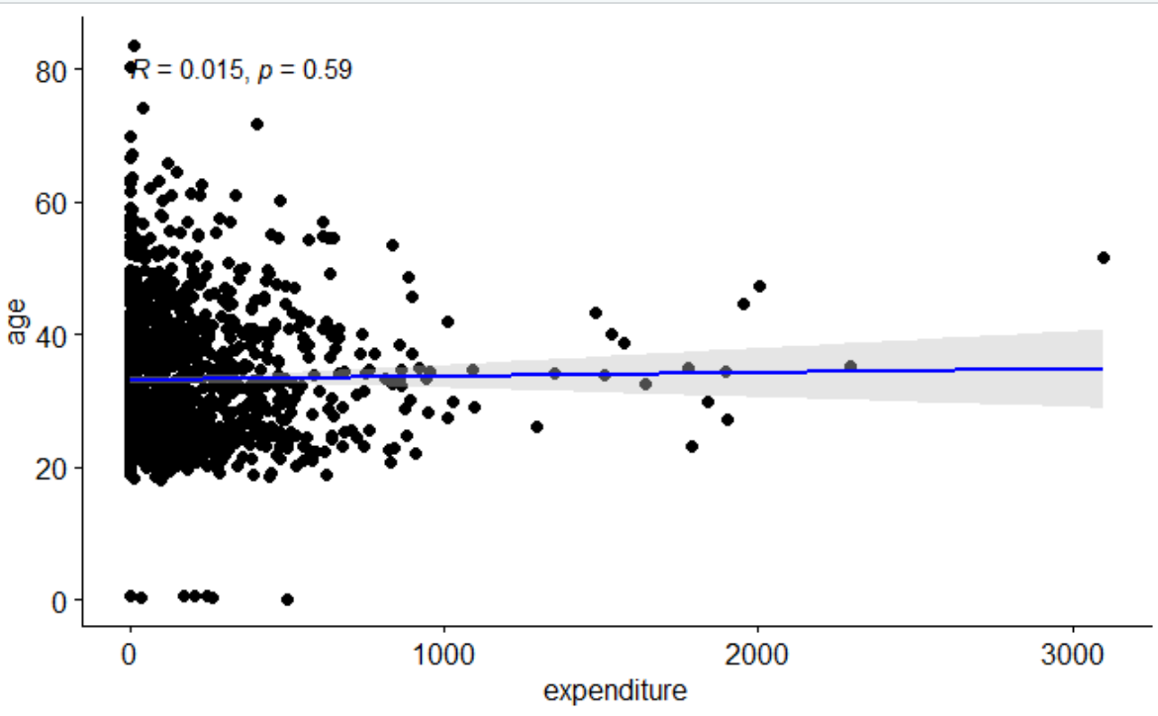
Scatter Plot
This scatter plot examines whether there is a correlation between age and expenditure when it comes to credit card applicants.
There is not a strong correlation between age and expenditure, but there do appear to be a couple outliers for expenditure.

Slide 10
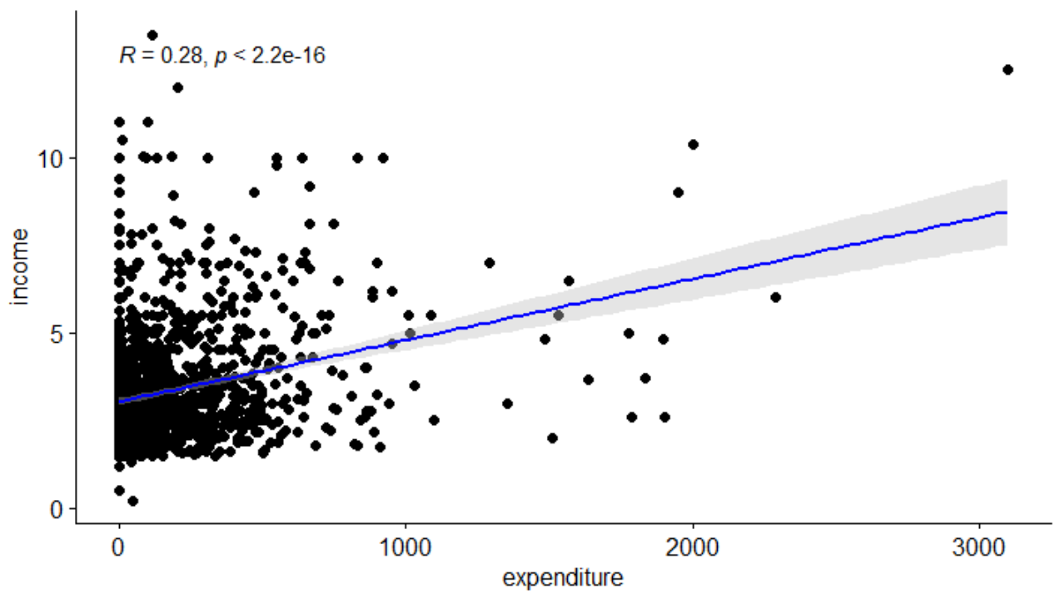
Scatter plot
This scatter plot shows correlation between income and expenditure when it comes to people interested in owning a credit card.
There appears to be a positive correlation between the two variables, so people who have more money may be more likely to spend more on their credit cards. Again we notice some outliers in expenditure.

Slide 11
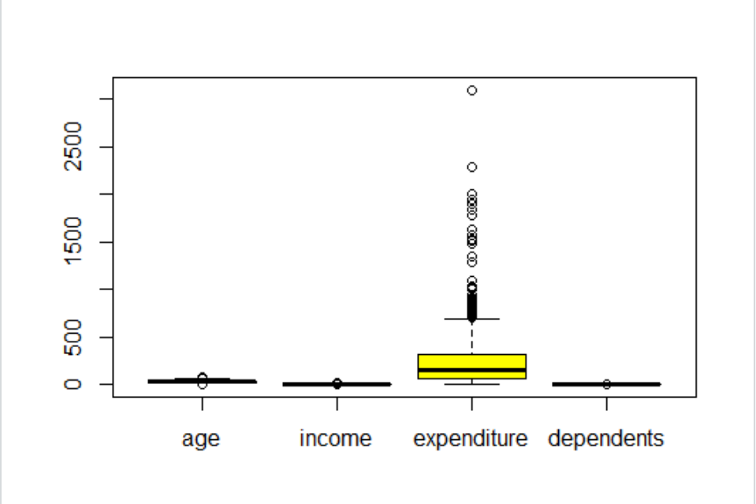
Distribution of Predictors
We want to observe distribution of age, income, expenditure, and dependents using box plots, but these variables are on different scales and, as we can see, expenditure has many severe outliers compared to the other predictors.
According to this box plot, the median for monthly credit card expenditure is about $200, Q1 expenditure is ~100 and Q3 is ~$400 and it has many severe outliers compared to other variables. Many outliers are around ~$700-$1000 and higher.

Slide 12
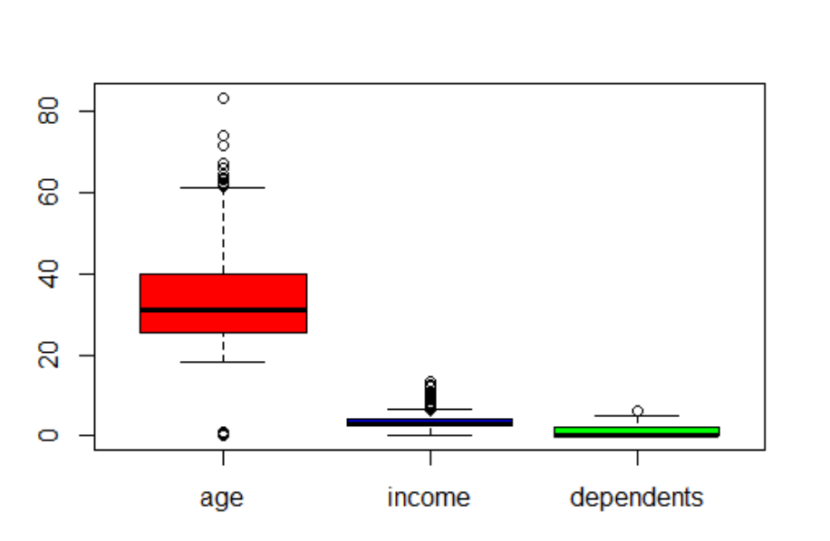
DISTRIBUTION OF PREDICTORS
Here, we show the same box plots but eliminate expenditure to take a closer view of age, income, and dependents. Still, due to the different numeric scales it is difficult to see income and dependents.
The median of age of credit card applicants is about 35, while Q1 age is ~25 and Q3 is 40. Many of the outliers for age are around 60-65 and above.

Slide 13
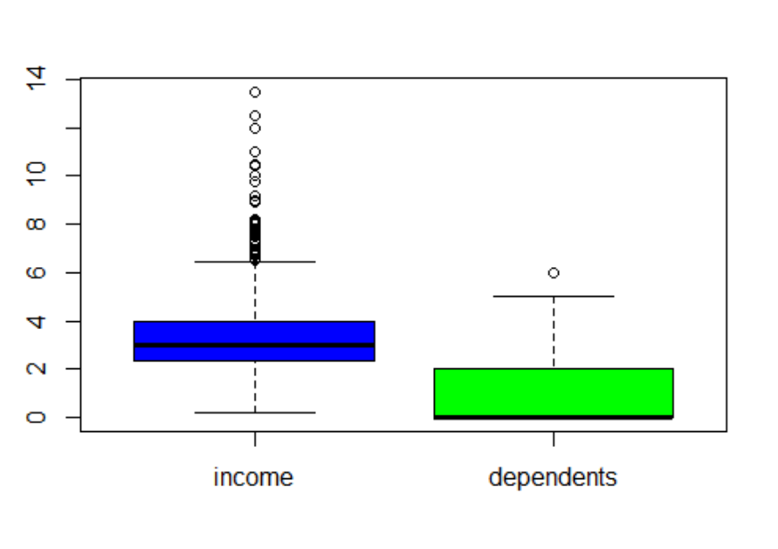
DISTRIBUTION OF PREDICTORS
Here we continue eliminate age from the previous box plot take a closer view of income and dependents.
According to this box plot, the median income using credit card is about $30,000, Q1 income point is ~ $25,000 and Q3 is $40,000. Many of the income outliers lie around $60,000 - $80,000 & $80,000 - $110,000 points of income.
For dependents, median and Q1 both appear to be around 0, and Q3 is 2, with dependents appearing to have the least outliers among other three variables.

Slide 14
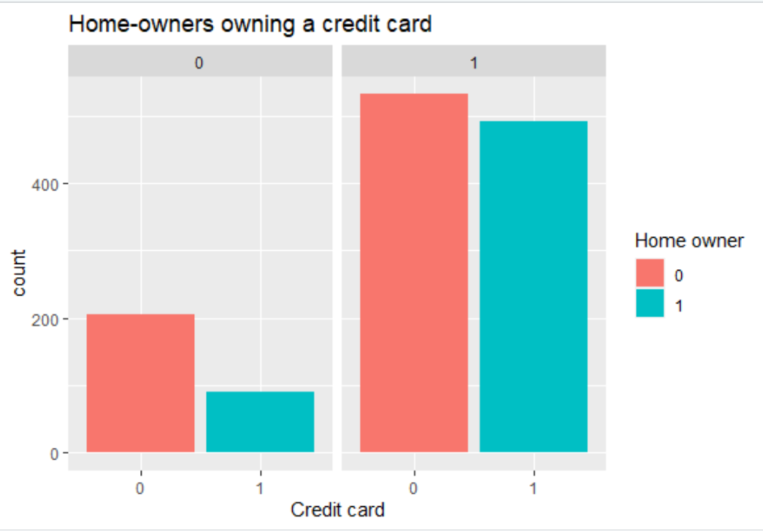
BAR PLOT
The bar graph shows the difference in approval by credit card applicants who aren't homeowners (red) and who are homeowners (blue).
The left side (credit card = 0) is for applicants who did not get approved. There are more than 200 non-homeowners who were not approved, and almost 100 homeowners who were not approved.
The right side (credit card = 1) is for the applicants who did get approved. There are more than 500 non-homeowners who were approved, and about 500 homeowners who were approved.

Slide 15
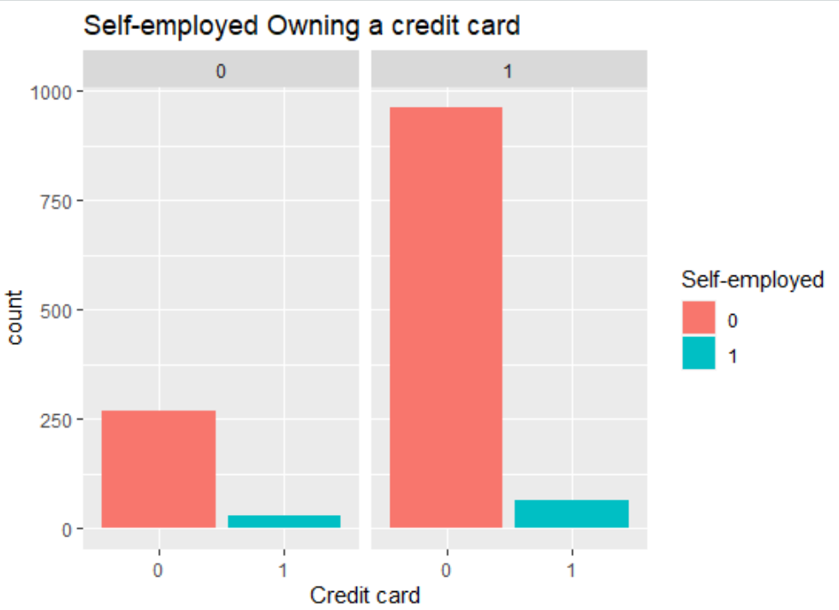
BAR PLOT
The bar graph shows the difference in approval by credit card applicants who aren't self-employed (red) and who are self-employed (blue).
The left side (credit card = 0) is for applicants who did not get approved. There are more than 250 applicants who were not self-employed and did not get approved, and around 20 self-employed applicants who did not get approved.
The right side (credit card = 1) is for the applicants who did get approved. There are almost 1000 applicants who were not self-employed and who were approved, and around 65 self-employed applicants who were approved.
Overall, many more applicants are not self-employed, but out of the self-employed applicants, there were more approvals than disapprovals.

Slide 16
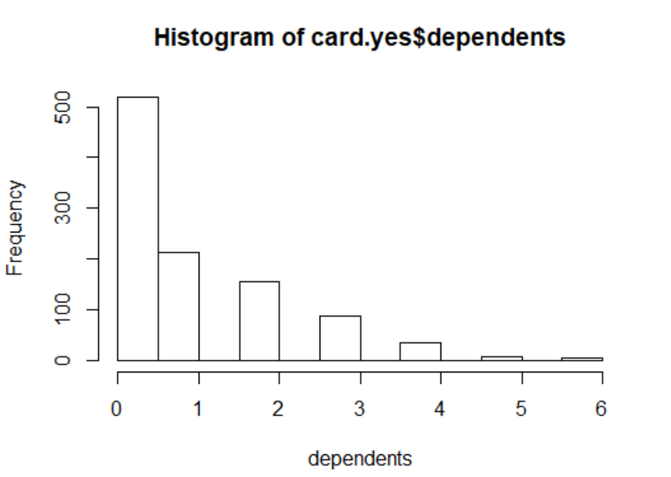
HISTOGRAM
This histogram shows the distribution of the dependents variable for applicants who were approved for a credit card.
We notice a positive skew, where most approved applicants only claimed 0-1 dependents.

Slide 17
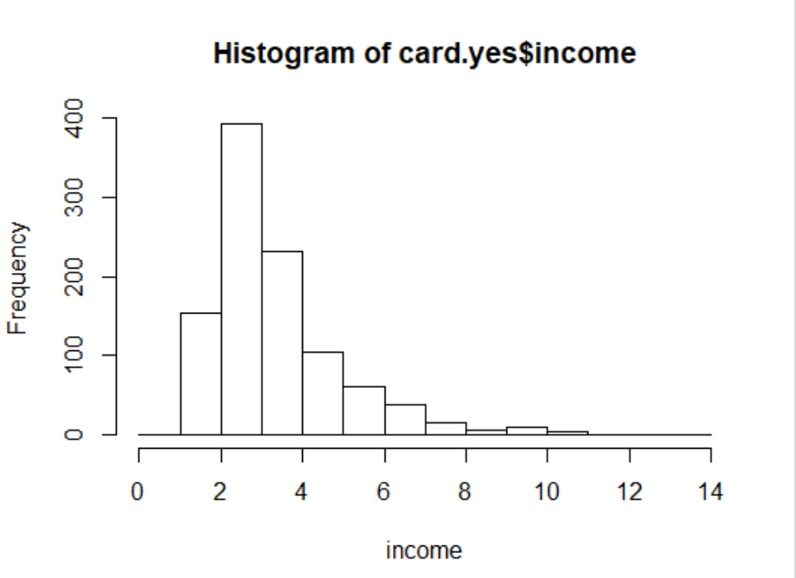
HISTOGRAM
This histogram shows the distribution of income for credit card applicants who were approved.
Income appears to be positively skewed for approved applicants, with the highest frequency in the $20-30k range.

Slide 18
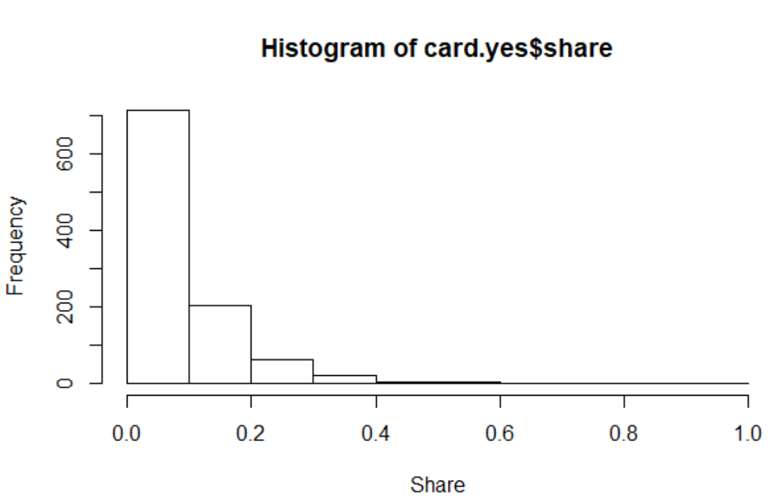
HISTOGRAM
This histogram shows the distribution of share (ratio of monthly credit card spending compared to annual income) for applicants who were approved.
Again, the variable is positively skewed for approved applicants.
Most approved applicants have a low share ratio, less than 0.1.

Slide 19
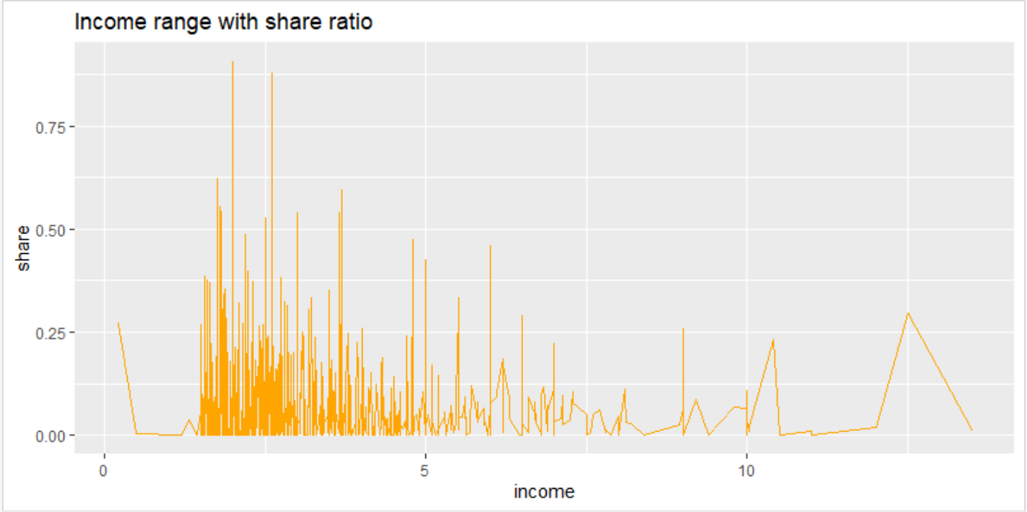
Referring to the line plot, it appears that applicants with income below $50,000 typically have a share ratio below 0.25. There are, however, exceptions as some applicants have a share ratio above 0.75, while their income is around $20,000 - $30,000.
From the histograms share and income above, we are curious about the share ratio (expenditure compared to income) and the applicant's income range. Therefore, we put the two variables in a line plot to examine the pattern.

Slide 20
Proposed Work
Our EDA so far has given us a good understanding of the relationships between variables in our dataset and how these variables are distributed. In the full EDA, we would want to include summary statistics as well as our heat map for numerical predictors. Our side-by-side box plots which show difference in predictor distribution for four numerical predictors based on approval/non-approval would also be good to include as they help us begin to understand which variables may be more useful predictors.
We have chosen three methods to use to classify records as 0 (not approved) or 1 (approved):
Reduced Linear Regression Model using Forward Selection
Discriminant Analysis
Random Forest
Each of these data mining techniques will be compared based on accuracy, sensitivity, specificity, and precision.

Slide 21
Forward Selection
Our first method to classify records will be a reduced linear regression model using forward selection, which starts with a null model with no predictors, then adds predictors to the model one at a time until the next predictor's contribution is no longer statistically significant.
We chose this algorithm because we are ultimately interested in finding a parsimonious model - the simplest model that performs sufficiently well, and forward selection will give us a simpler model than a full linear regression model would.
A possible disadvantage of this method is that it may miss predictors that perform well together, but perform poorly individually.

Slide 22
Discriminant Analysis
The second data mining technique we will use in order to classify records is discriminant analysis, which uses statistical distance and will take into account the correlation between predictors, unlike forward selection. We will end up with classification functions for 0 (application not approved) and 1 (application approved).
Discriminant analysis assumes normality of predictors, and it assumes correlation among predictors within a class is the same across all classes. This method can also be sensitive to outliers. We chose discriminant analysis because we found it to be very robust and suitable for a dataset of our credit card data's size.
We will be standardizing everything to a 0-1 scale before performing discriminant analysis and our final method random forest.

Slide 23
Random Forest
The final data mining algorithm we will use to classify records is random forest, which draws multiple random samples from the data each using a random subset of predictors to create a tree. It then combines classifications from all trees that make up the "forest," and the majority vote from all these trees determines what class the record will fall into.
We chose random forest because of its strong performance as well as the fact that we can extract information such as variable importance scores. This method does not lay out the rules like a single classification tree, but it tends to have even better classification performance and it is still easy to interpret and understand.

